Slide 1
BARCELONA WORKSHOP
Nutrition, Physical Activity & Cancer. 14/3/19
Expert meeting. Invitations via direct contact only
Registered attendees: 53
Guest speakers: x5 nutrition + x4 physical activity
Notes:
Expert meeting to try to determine the most up-to-date approaches to Nutritional care and Physical activity ad co-adjuvants in cancer treatment and prevention.

Slide 2
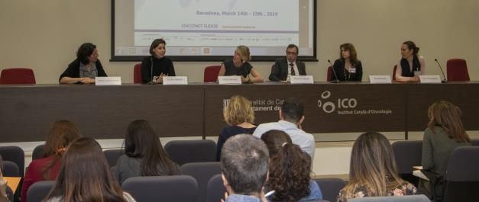
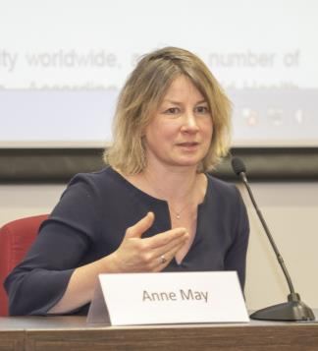
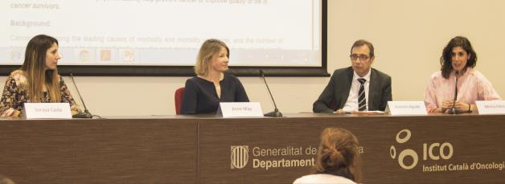
Dr. Anne MAY
Department of Epidemiology. Julius Center for Health Sciences and Primary Care.
Notes:
Looked at some large epidemiological research on the Mediterranean diet.
Circadian rythms
Lipid metabolism
Physical activity, sedentary behavior
Impact of exercise on cancer and the underlying mechanisms….

Slide 3
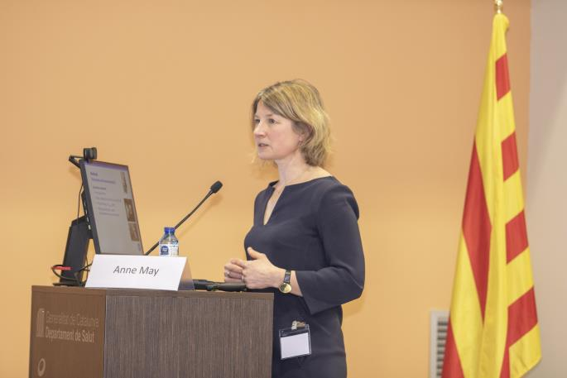
BARCELONA WORKSHOP

Slide 4
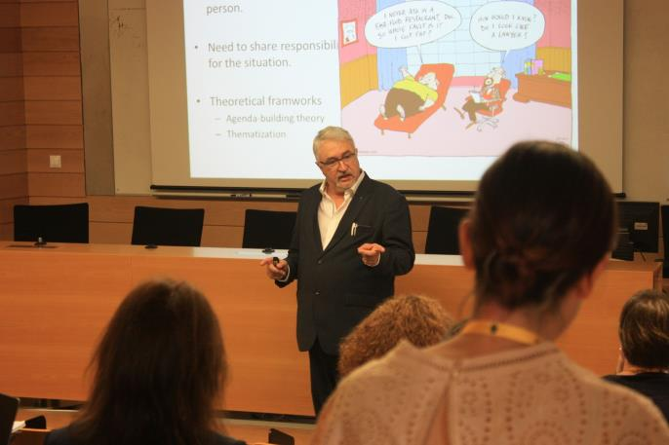
BARCELONA WORKSHOP

Slide 5
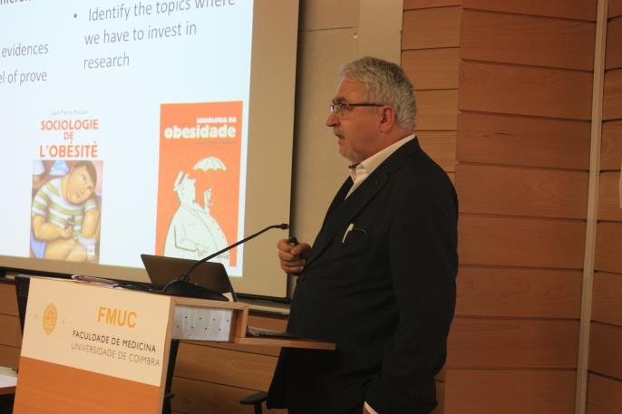
BARCELONA WORKSHOP

