Slide 1
COIMBRA WORKSHOP
3 days ( 7-9 Sept. 2017). Registered attendees: 46
Personalized complex care in obese oncologic patients
Format: Theory + Expertise/opinion exchange
Obesity – division in 4 main tracks for discussion
Notes:
The first workshop took place shortly after ICO’s joining the Onconet Project.

Slide 2
Nutr. screening
Measurements
Malnutrition
Individualized tt.
Recommendations
Bioactive compounds
Fasting
Herb-drug interactions
Adjust. Treatm.
Dosaging
New markers
Toxicity management
Preconceptions
Professionals
Relatives/care givers
Patients
DR JEAN-PIERRE POULAIN
SOCIOLOGIST
Notes:
2…Bioactive compounds (nutraceuticals) targeting molecular alterations
…Fasting and other life-style interventions
…”all-natural producsts can change pharmacokinetics and hormone levels (* follow up)
3… Excessive adipose tissue may have consquences and so can losing weight

Slide 3
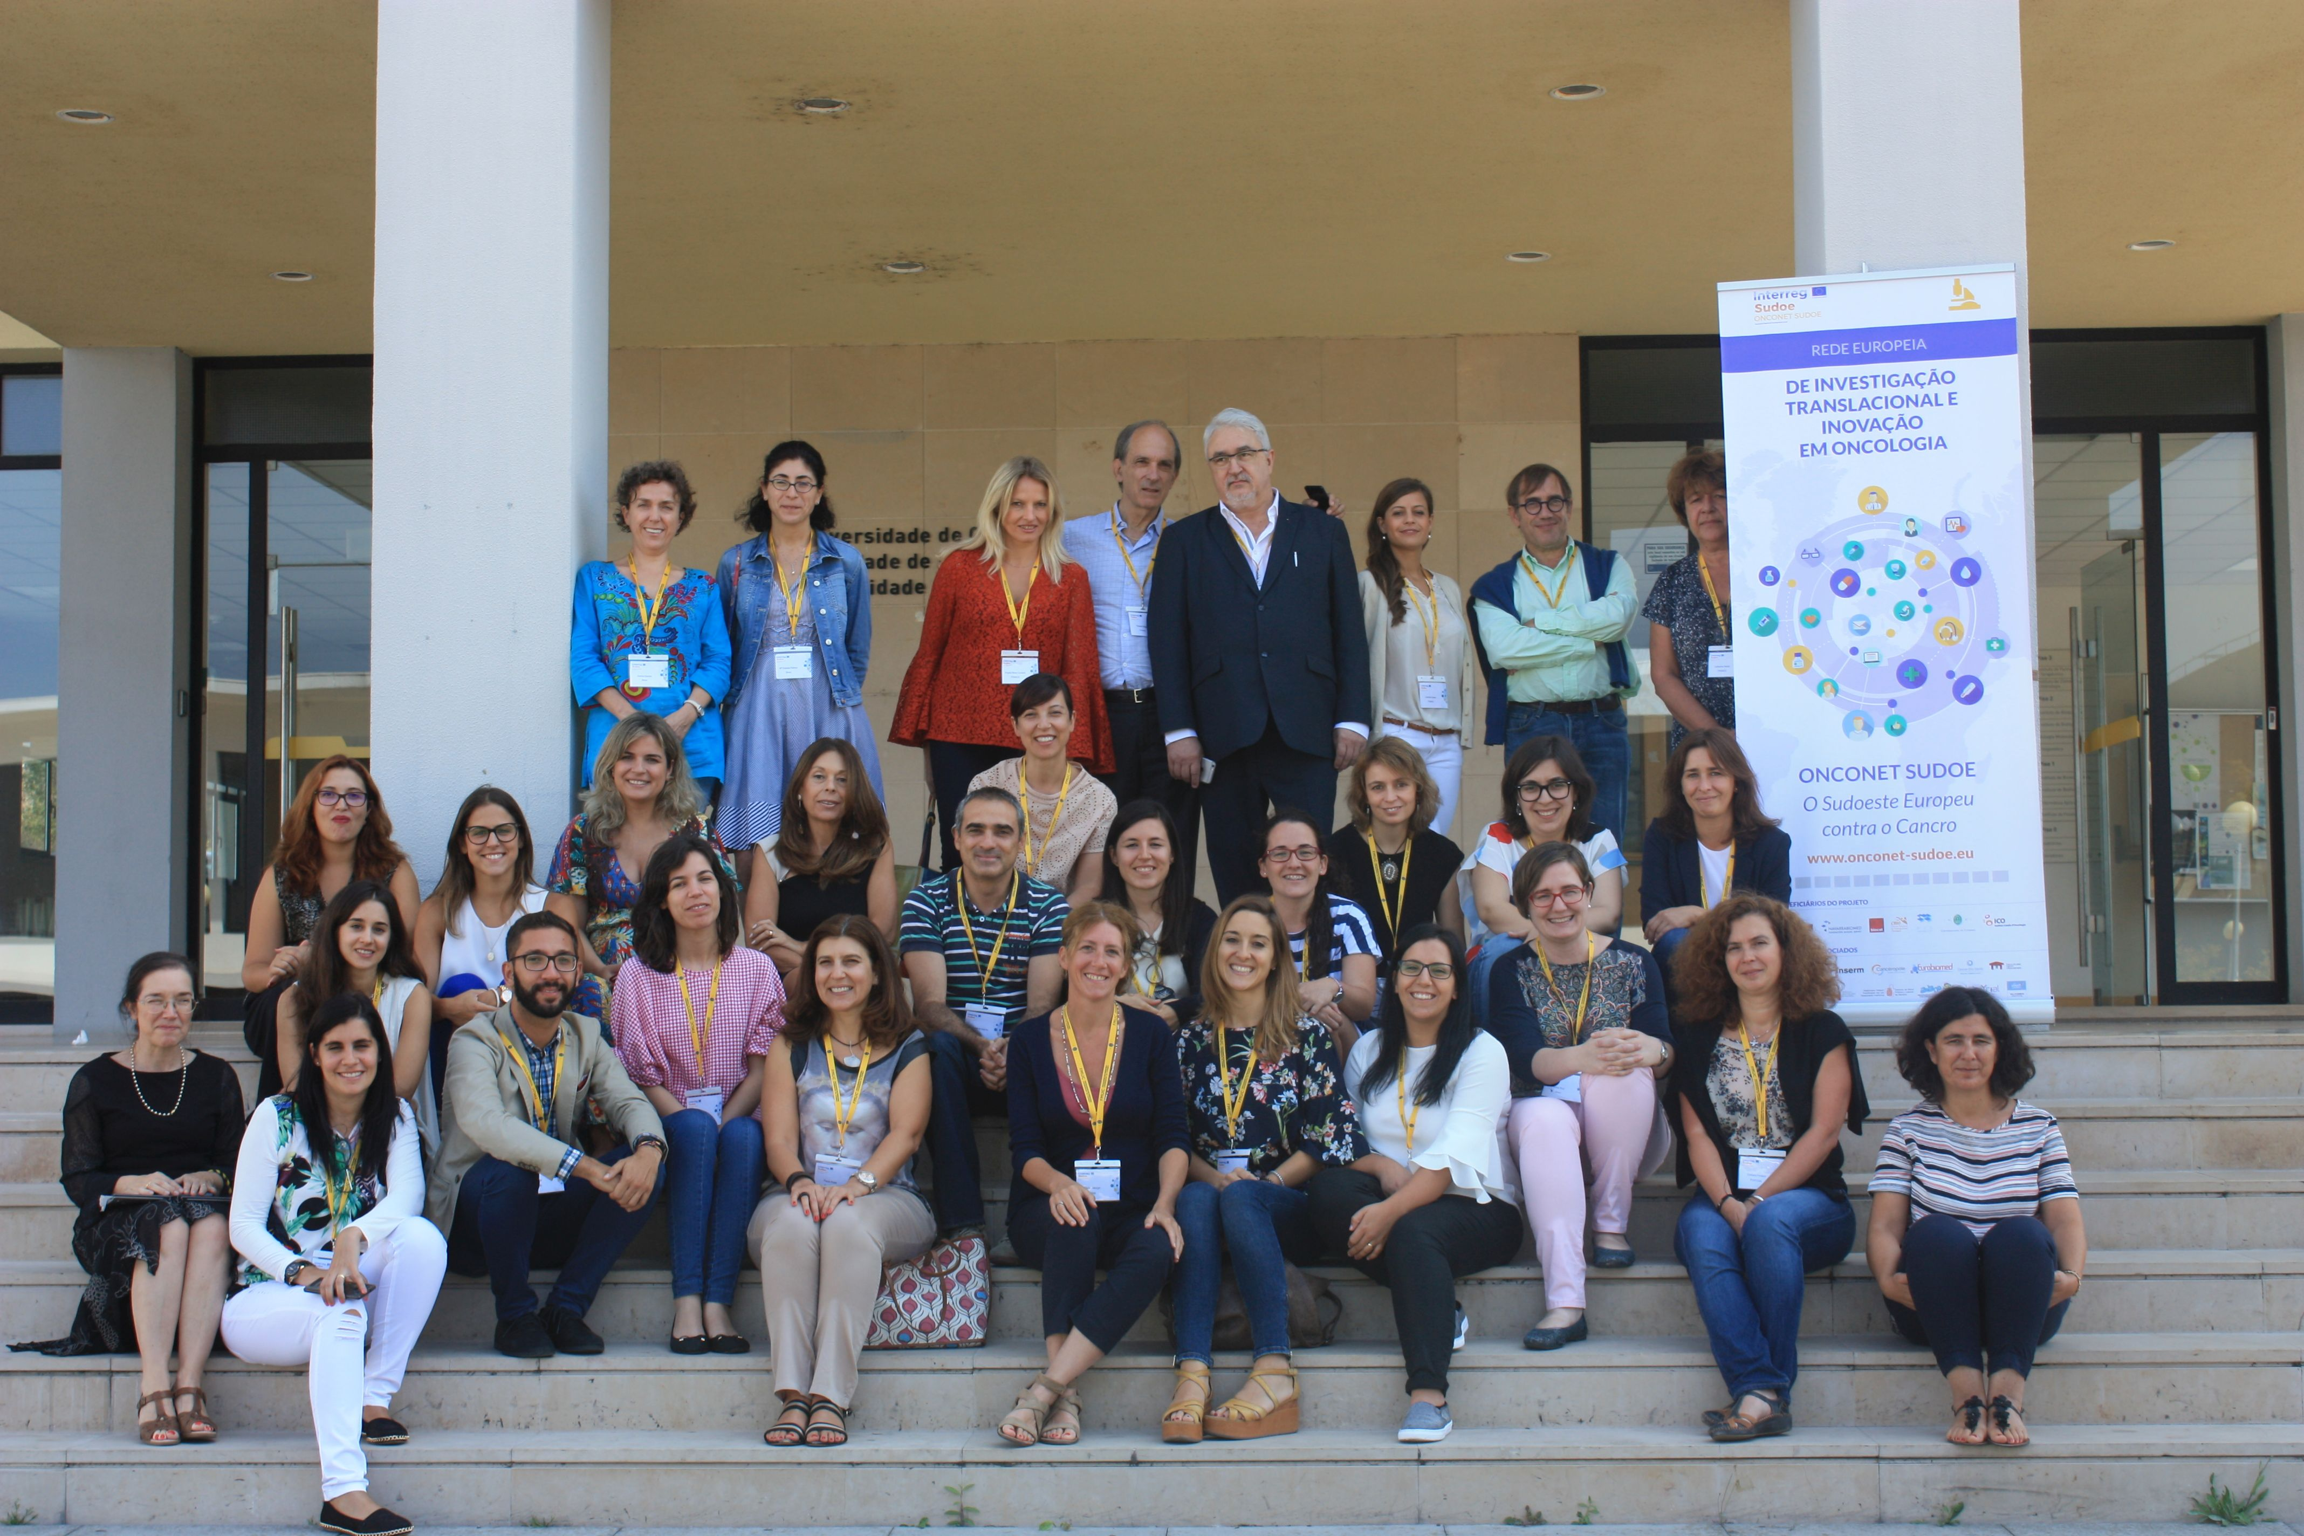
Coimbra 2017

Slide 4
Merci beaucoup!

