Slide 1
Nutrition,
Physical Activity
& Cancer

Slide 2
PARTNERS
Notes:
Project coordinator
Partner institutions

Slide 3
ONLINE COURSES x2
Nutrition, physical activity and cancer prevention
COURSE 1.- PREVENTION
Primary care level.
COURSE 2.- PREV&TREATMENT
Specialised care providers
Module 1: General nutritional concepts and relation to cancer
Module 2: Recommendations on cancer prevention
Module 3: Advanced topics
E.g.: carcinogens, anti-carcinogens, dietary patterns, supplements, body composition, chronodiet
Module 3: Advanced topics
E.g.: nutritional screening/tt, consequences of antineoplastic treatments, malnutrition, herb-drug interactions

Slide 4
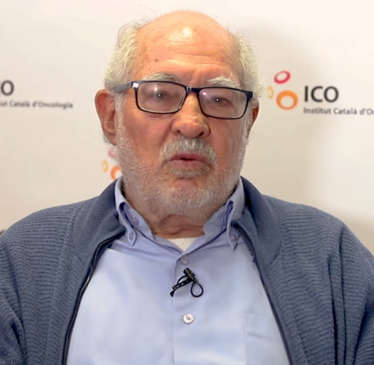
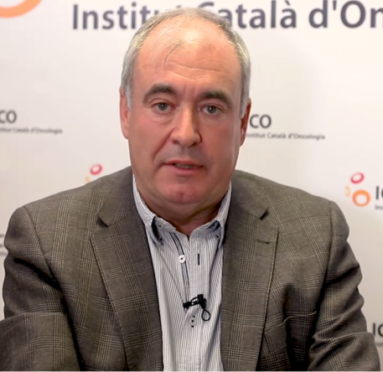
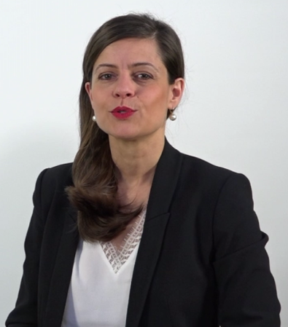
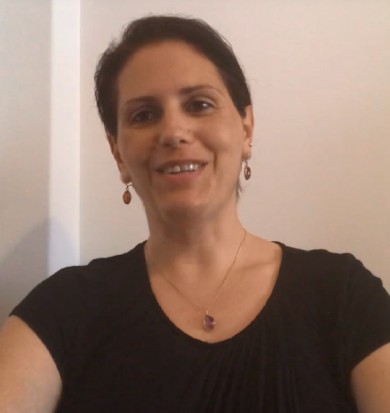
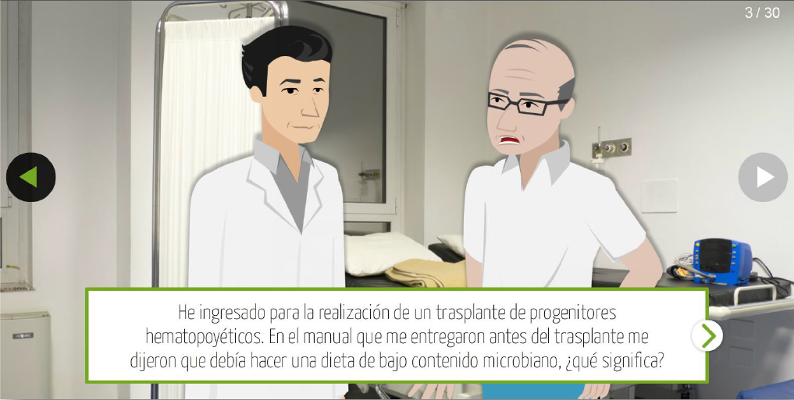
MULTIMEDIA
VIDEOS
SPAIN
Carlos A. GONZALEZ
SPAIN
Ricard MESIA
Charlotte VAYSSE
FRANCE
Paula RAVASCO
PORTUGAL
AUDIO
ACTIVITIES
CLINICAL SCENARIOS

Slide 5
https://www.e-oncologia.org/en
3 EDUCATIONAL BRANCHES:
Corporate Education
Academics (master, postgrad)
Online Education (1 Master SEOM 1500 hours (Medical residents); 1 Postgrad course (750 hours).

Slide 6
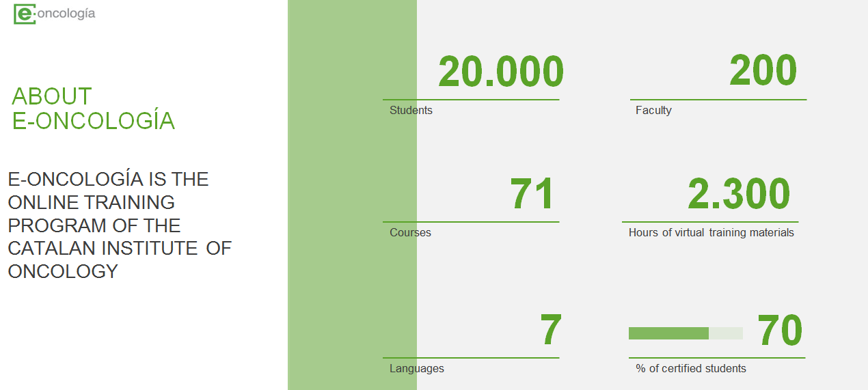
https://www.e-oncologia.org/en
Notes:
And this is what it looks like

Slide 7
@ONCONET_SUDOE
Interreg Sudoe Programme

